Slide 1
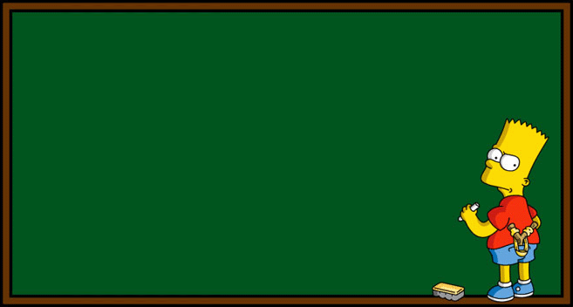
Midpoint of a Line
Grade D
05/07/2012
Learning Objectives:
Able to identify co-ordinates
Able to identify the midpoint of a line
Able to calculate the length of a line

Slide 2
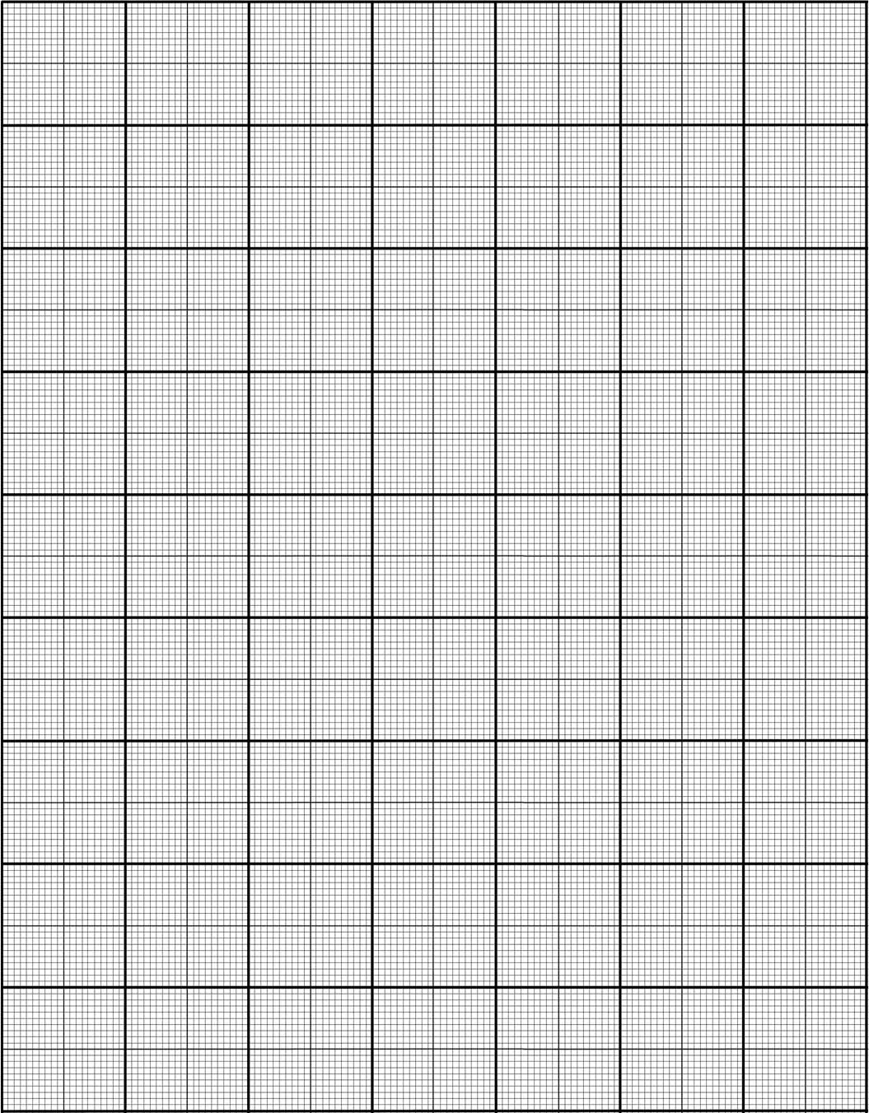

y
5
4
3
(1, 3)
(3, 3)
(5, 3)
(-5, 2)
2
1
$$x$$
-7
-6
-5
-4
-3
-2
-1
0
1
2
3
4
5
6
7
(-5, -1)
-1
-2
-3
(-5, -4)
-4
-5

Slide 3
y
(5, 5)
5
4
(3, 3)
3
4
2
2
1
4
(1, 1)
2
$$x$$
-7
-6
-5
-4
-3
-2
-1
0
1
2
3
4
5
6
7
-1
3
6
(0, -2)
-2
½
1
(3, -2.5)
(-6, -3)
-3
-4
-5

Slide 4
y
(5, 5)
What do you notice about the co-ordinates of the midpoints of the lines, compared to the co-ordinates of the points at each end of the line?
5
4
(3, 3)
3
2
1
(1, 1)
$$x$$
-7
-6
-5
-4
-3
-2
-1
0
1
2
3
4
5
6
7
-1
(0, -2)
-2
(3, -2.5)
(6, -3)
-3
-4
-5

Slide 5

Midpoint of a Line
To find the midpoint of a line:
Go halfway between the two $x$ co-ordinates
Go halfway between the two $y$ co-ordinate

Slide 6
Some practice…
Complete the worksheet

Slide 7
Starter
Copy and complete the table below
Starting Point | Midpoint | End point
(2, 6) |  | (4, 10)
(3, 7) |  | (7, 1)
(-2, -10) |  | (-8, 0)
(1, 5) | (3, 9)
 | (0, 0) | (9, 5)
(3, 8)
(5, 4)
(-5, -5)
(5, 13)
(-9, -5)

Slide 8
Length of a Line Segment
Grade C
05/07/2012
Learning Objectives:
Able to find the midpoint of a line
Able to recall Pythagoras’ Theorem
Use it to calculate the length of a line

Slide 9

Length of a Line Segment
What could I use to measure the length of the line AB?
y
(6, 3)
c² = a² + b²
c² = 4² + 2²
c² = 16 + 4
c² = 20
c = √20
c = 4.47 (2dp)
3
B
2
2
A
1
4
(2, 1)
$$x$$
-7
-6
-5
-4
-3
-2
-1
0
1
2
3
4
5
6
7
-1
-2
-3

Slide 10
Length of a Line Segment
What is the length of the line CD?
c² = a² + b²
c² = 4² + 5²
c² = 16 + 25
c² = 41
c = √41
c = 6.40 (2dp)
y
3
2
C
(-4, 1)
1
$$x$$
-7
-6
-5
-4
-3
-2
-1
0
1
2
3
4
5
6
7
4
-1
-2
(1, -3)
-3
5
D

Slide 11
Length of a line segment
What is the length of the line between the points (1, 6) and (5, 9)?
c² = a² + b²
c² = 4² + 3²
c² = 16 + 9
c² = 25
c = √25
c = 5
(5, 9)
3
(1, 6)
4

Slide 12
Length of a Line Segment
What is the length of the line AB?
c² = a² + b²
c² = 9² + 5²
c² = 81 + 25
c² = 106
c = √106
c = 10.30 (2dp)
y
3
B
(4, 2)
2
1
$$x$$
-7
-6
-5
-4
-3
-2
-1
0
1
2
3
4
5
6
7
5
-1
-2
A
-3
9
(-5, -3)

Slide 13
Length of a Line Segment
What is the length of the line CD?
c² = a² + b²
c² = 1² + 6²
c² = 1 + 36
c² = 37
c = √37
c = 6.08 (2dp)
y
D
3
(2, 3)
2
1
$$x$$
-7
-6
-5
-4
-3
-2
-1
0
1
2
3
4
5
6
7
-1
-2
-3
C
(1, -5)

Slide 14
Length of a line segment
What is the length of the line between the points (2, 1) and (4, 10)?
c² = a² + b²
c² = 2² + 9²
c² = 4 + 81
c² = 85
c = √85
c = 9.22
(4, 10)
9
(2, 1)
2

Slide 15
Your turn
Complete the worksheet in your books

